Slide 1
Soduko

Slide 2
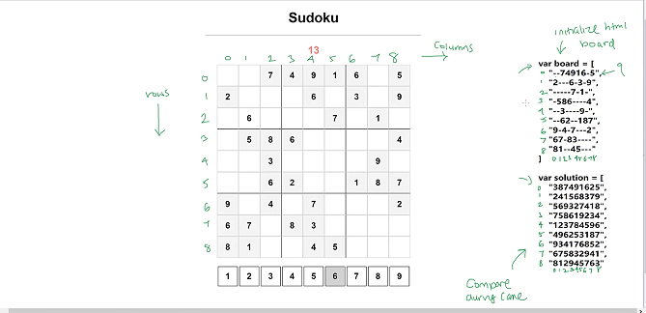
Sudoku Game Planning

Slide 3
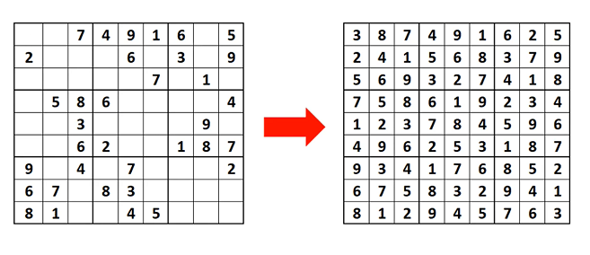
Sodoku initial and final structure

Slide 4
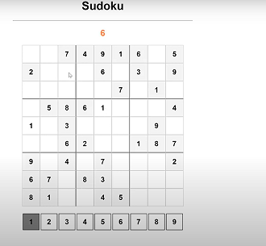
Sudoku Final Game output

